Slide 1

Indoor Furniture Placement Copilot for Optimal Design
Team 14
Instructor: Prof. Osama Alshaykh
Group member: Yongyi Xie

Slide 2
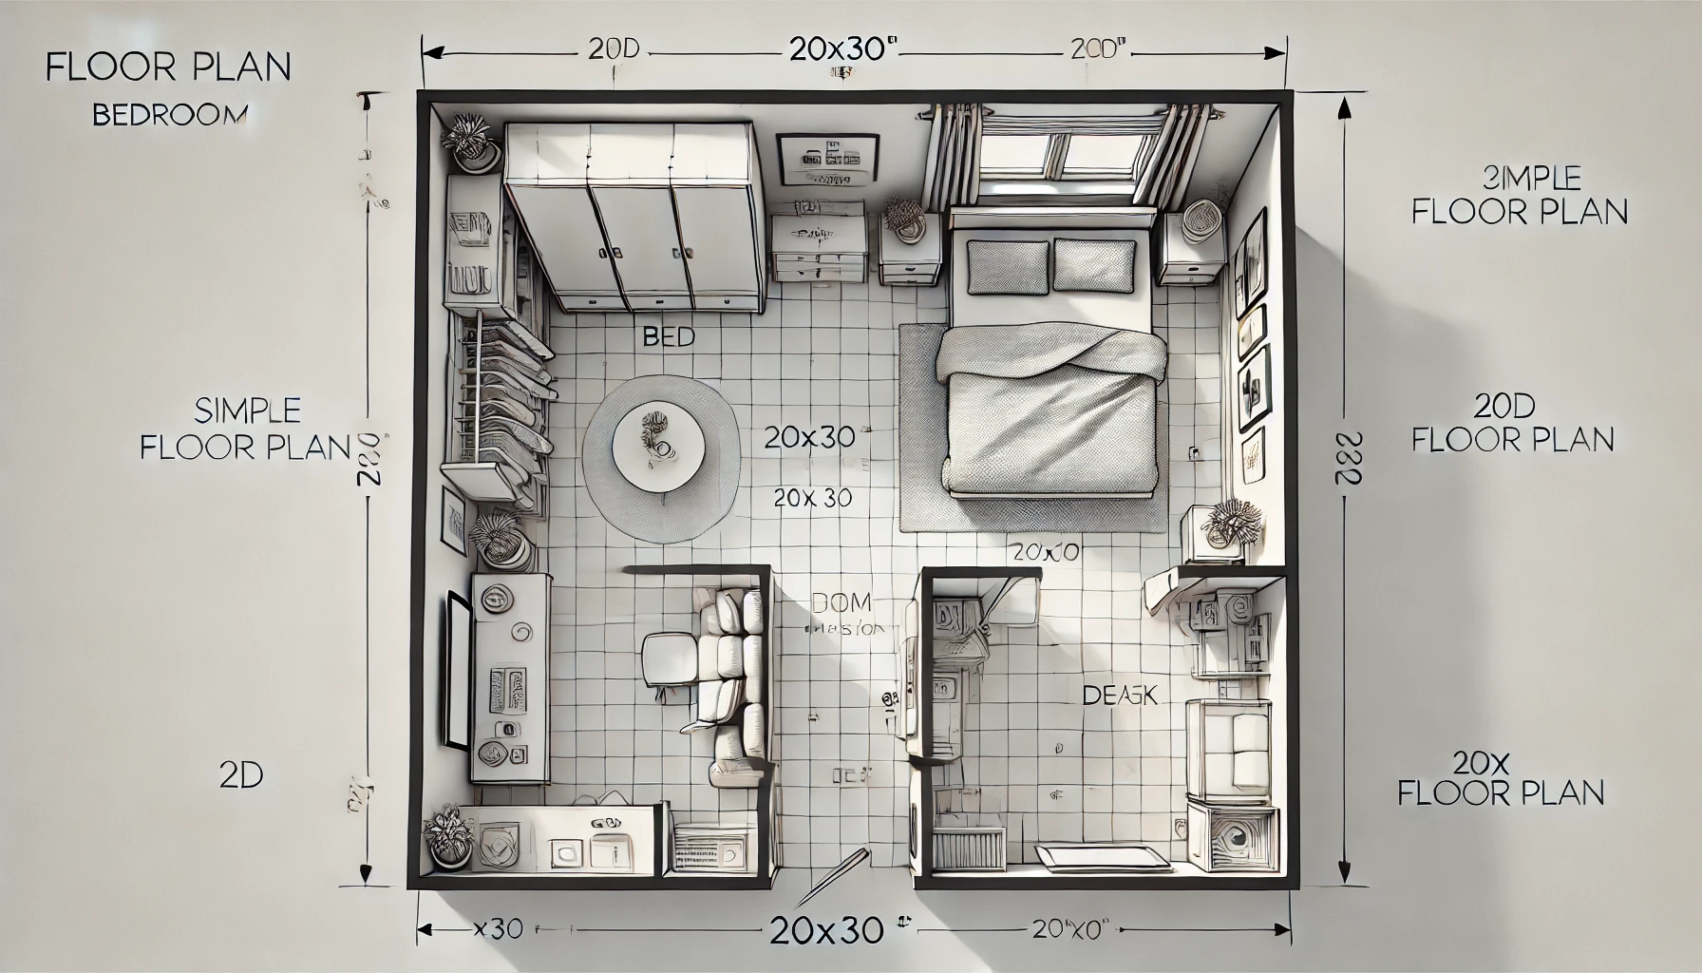
Design Problem
Background
Homes more intelligent and personalized, optimizing space for both aesthetics and functionality is essential
Large language models (LLMs) offer new opportunities for them
Mission Statement
Develop a tool that can give furniture placement plans based on safety and comfort
Fig.1 : Furniture plan designed directly by
ChatGPT prompts. Obviously it is not doing a good job. ☹

Slide 3
Targeted Users & Minimum Valued Product
Target market: Indoor Furniture
Consumer: Individuals
User: Parents with children, People with Disabilities, Roommates
Word spreader: Direct users, their family members or supervisors, their roommates
Minimum Valued Product (MVP):
Analyze activity paths of users
Provide basic furniture arrangement
Allow users to modify room and furniture
Generate graphical layout

Slide 4
Minimum Valued Product
Requirements | Comparison |  |  |  |  |  |  | Sum | Percentage
 | 1-2 |  | 1-3 | 1-4 | 2-3 | 2-4 | 3-4
 | 0 | 1 |  | 0
Analyze activity paths of users |  |  |  |  |  |  |  | 1 | 17%
 | 1 |  |  |  | 1 | 1
Provide basic furniture arrangement |  |  |  |  |  |  |  | 3 | 50%
 |  | 0 |  |  | 0 |  | 0
Allow users to modify room and furniture |  |  |  |  |  |  |  | 0 | 0%
Generate graphical layout |  |  |  |  |  |  |  | 2 | 33%
 |  |  |  | 1 |  | 0 | 1
Total |  |  |  |  |  |  |  | 6 | 100%

Slide 5
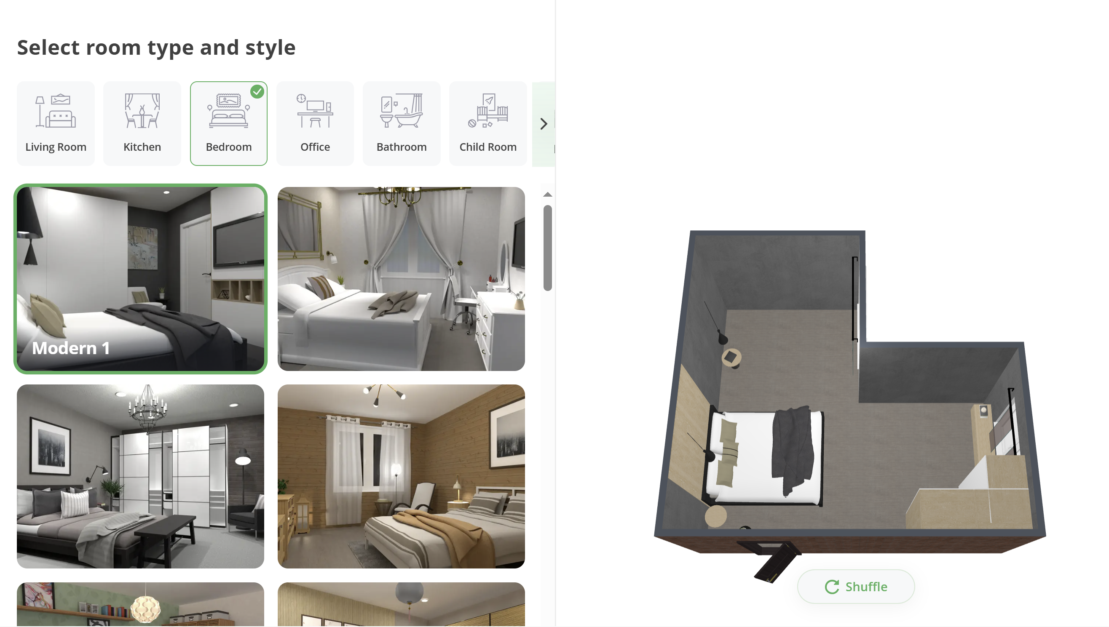
Literature Review
AI-driven interior design [1][2]
Recognizing and interpreting indoor spaces [3][4]
Deciphering spatial distributions within indoor environments[5][6]
Using synthetic data as training data [7]
Figure 2. Example of an AI-driven Interior Design
(Planner-5D)
https://planner5d.com/editor?key=wizard&mode=wizard#

Slide 6
Benchmarking
AI Tools | Path Analysis | Basic furniture placement | Modify room and furniture | Graphical layout
Planner-5D | 0 | 3 | 2 | 3
REimagineHome | 0 | 2 | 1 | 2
Foyr Neo | 1 | 3 | 2 | 2
DecorMatters | 1 | 2 | 3 | 1

Slide 7
Engineering specifications (ES)
Data Input and Collection
Path Data Processing and Analysis
Furniture Placement and Optimization
User Interface (UI) and Experience (UX)
System Integration
Safety and Compliance
Performance and Testing

Slide 8
What have done so far
Literature Review & Benchmarking
Data Acquisition and generation
Discover real-world datasets
Generate synthetic data based on simulations
Data preprocessing before analysis
Algorithm preparation
K-means, DBSCAN
Machine Learning Related

Slide 9
What to do next
Implement backend
Activity analysis
Optimization of furniture placements
Implement frontend
Basic Design Output
User Interface for adjustments
Changes output as required
Possible improvements

Slide 10
Challenges Facing
Hardware
Software
Mental

Slide 11
Project Schedule

Slide 12

THANK YOU!
xyy0208@bu.edu
https://github.com/van1dh/Indoor-Furniture-Placement-Copilot/tree/main

